Slide 1


TEAM 7
Smart Reactive Robot
312605015 詹恆瑜 313605019 方敏
Notes:
Hello everyone, we are Team 7, and our project title is Smart Reactive Robot.

Slide 2
Motivation
This project combines an ultrasonic sensor and a camera to simulate acceleration responses to rear threats and front target recognition, achieving flexible obstacle avoidance and target tracking while exploring the basic implementation of simplified self-driving technology.
Notes:
動機1min
In our project, we combine an ultrasonic sensor and a camera to give the robot these abilities. The ultrasonic sensor detects objects approaching and makes the robot speed up if something gets too close. The camera detects different colors and triggers different reactions from the robot. This simple design allows the robot to avoid obstacles and demonstrate basic self-driving car concepts. Our goal is to create a robot that moves safely and intelligently.

Slide 3
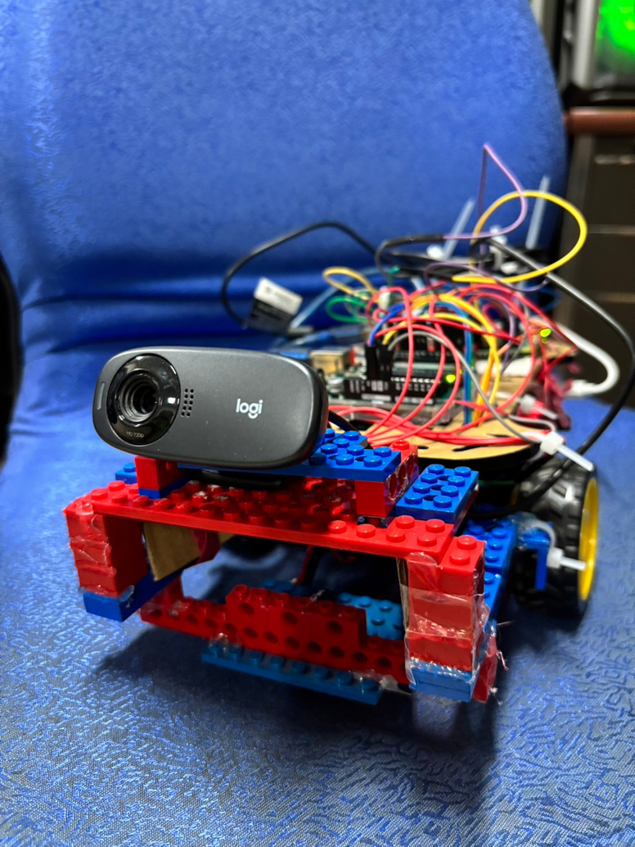
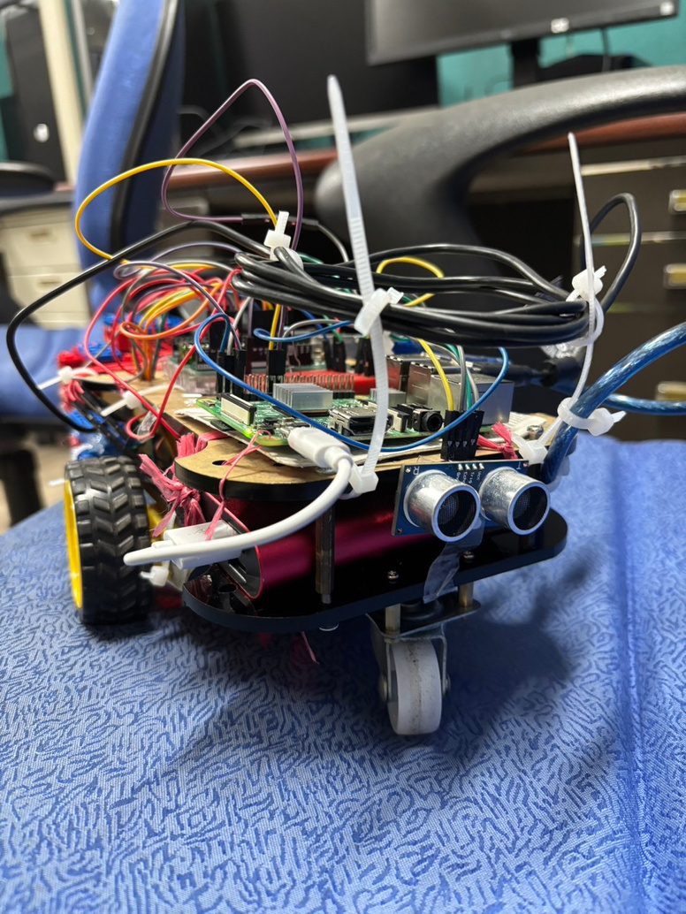
Equipments
Camera
Ultrasonic Sensor
Notes:
設備 0.5min
These are the main parts of our robot. On the left is the camera, placed at the front. It helps the robot see and recognize objects ahead. On the right is the ultrasonic sensor, at the back. It checks for objects behind the robot. Both parts work together to help the robot move and respond to its surroundings.

Slide 4

Function
Simulated Scenerio
System
Shutdown Signal
Encounter
Animal
Red Light
Green Light
Reaction
Turn off
Camera
Turning then
Go Straight
Stop
Go Straight
Notes:
2min
Our robot uses color detection to handle different simulated scenarios. For example, when the camera sees red, it simulates stopping at a red traffic light by halting for a few seconds. If the robot detects green, it represents a green light, and the robot moves forward as normal. When the system detects a shutdown signal, like blue, it turns off the camera, simulating a system shutdown. If the robot sees orange, representing an animal on the road, it turns to avoid the obstacle and then continues forward. These color-based reactions allow the robot to adapt to different situations, making it more intelligent and versatile.

Slide 5
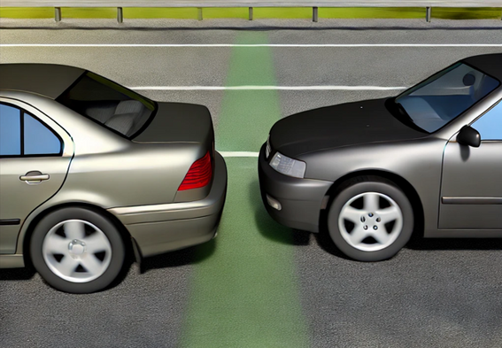

Function
Simulated Scenerio
Tailgating
General
Reaction
Speed up
Maintain Normal Speed
Notes:
1 min
This slide shows how the robot handles objects behind it and controls its speed. If something comes too close to the back, like another car following too closely, the robot speeds up to get away, just like in a real driving situation. When there’s nothing behind it, the robot moves at a normal speed. These features help the robot move safely and show how it could handle basic driving scenarios.

Slide 6

Demo
Notes:
1 .5min
Start, we turn on the robot and activate the camera at the same time. If the robot sees green paper, means green light, it starts moving forward. If something gets too close behind it, it speeds up until it maintains a safe distance. When it sees red paper, which means red light, it stops. It will only move again after seeing green paper. If it sees orange paper, means something suddenly appeared or it’s about to hit something, so it makes turning and then keeps going. If we want to stop the robot and end the program, we show it red paper first, and then the blue paper. The blue paper is a stop signal, and you'll see the camera shutdown too. That's our robot show demonstration thanks for listening!

Slide 7
Thanks for Listening

